Slide 1
PLP
Presentation
3rd September, 2018

Slide 2
1. Soumya Gupta (152915)
WAN & LAN
Redundancy of Network
DNS
2. Naredla Gangavamshi (152851)
File Server
Web Server
Web Access & Redundancy
3. Samiti Rahul (152907)
Directory Server
User Authentication & Redundancy
4. Aastha Verma (152537)
Mail Server
SFTP
Printer Services
5. Jabbireddy Gireesha (152659)
VPN
Proxy Services
Firewall

Slide 3
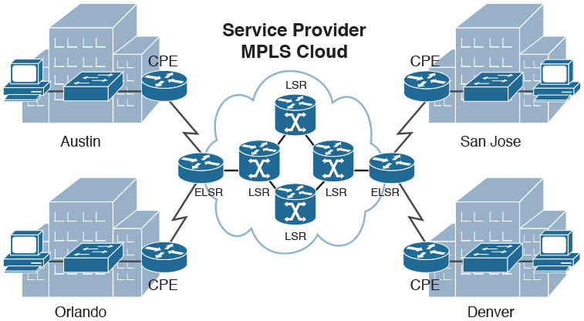
WAN Architecture
Asia
APAC
Europe
Middle-East
US

Slide 4
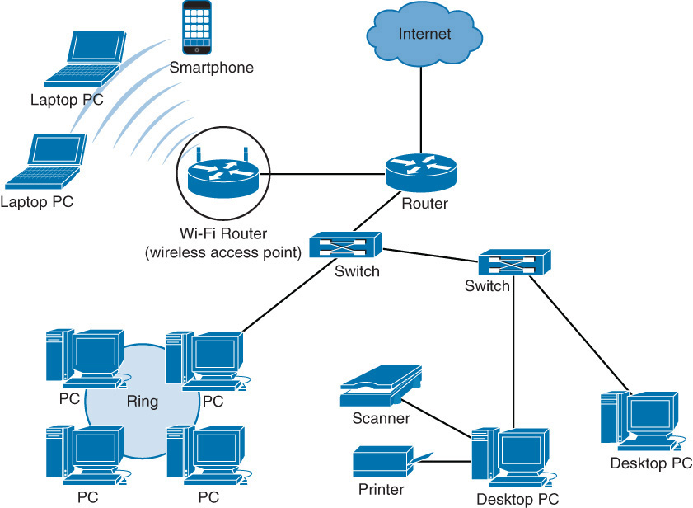
LAN Architecture

Slide 5
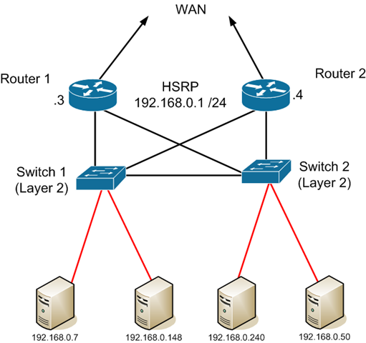
Redundancy of Network

Slide 6
Service Architecture

Slide 7
DNS

Slide 8
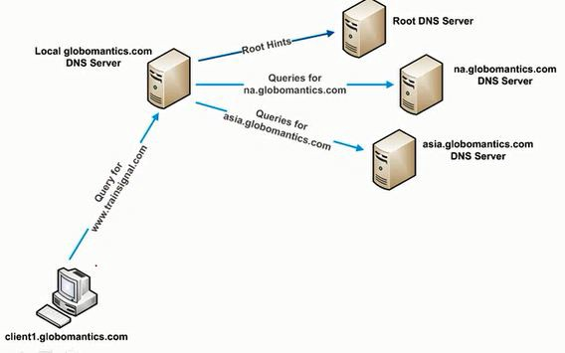
DNS Logical Architecture
Root DNS
Server
Root hints
Local DNS
Server
Queries for
na.capgemini.com
DNS Server
na.capgemini.com
Query for
www.capgemini.com
Queries for
www.capgemini.com
DNS Server
www.capgemini.com
www.capgemini.com

Slide 9
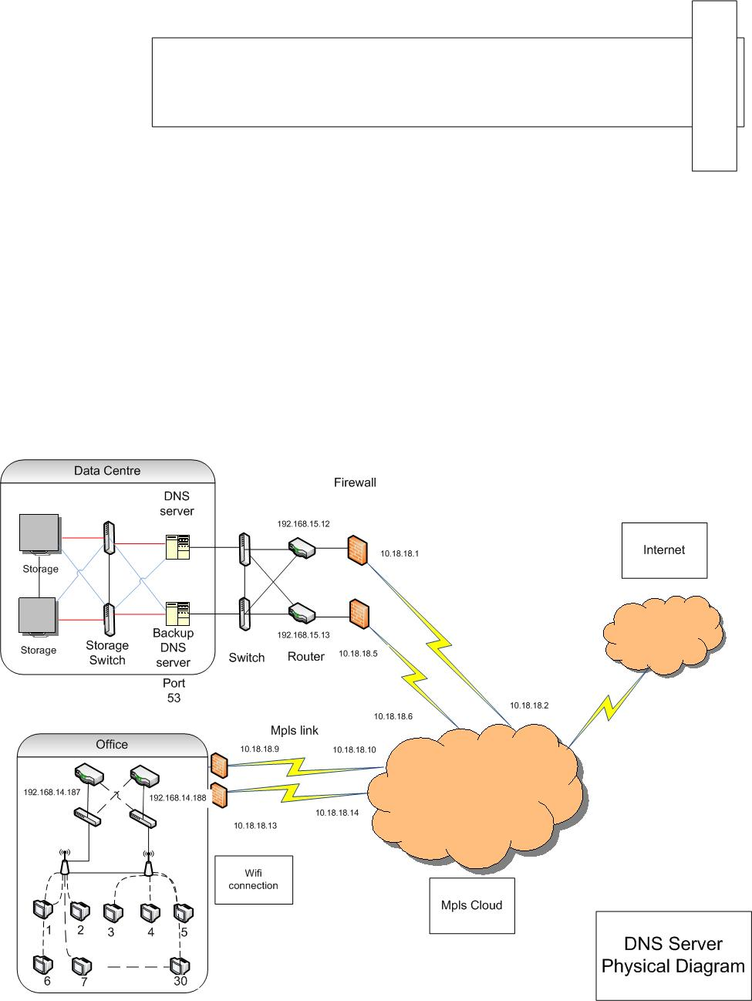
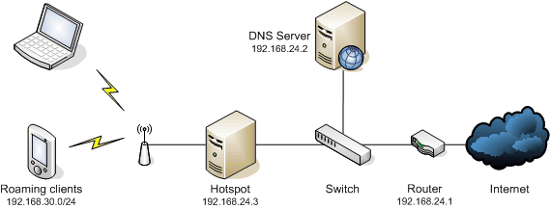

DNS Physical Architecture
ISP

Slide 10
File Server

Slide 11

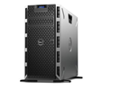
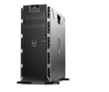




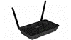
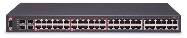
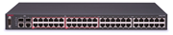

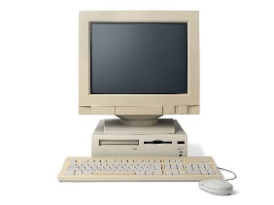
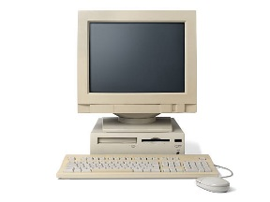
File server (Logical Architecture)
File share
File servers
Mpls cloud
DNS server
Proxy server
Host 1
Host 2

Slide 12
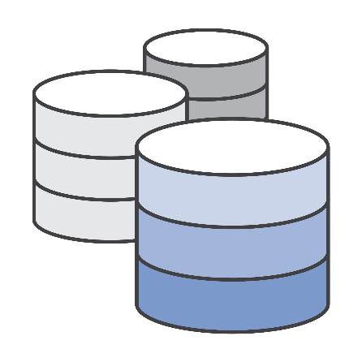

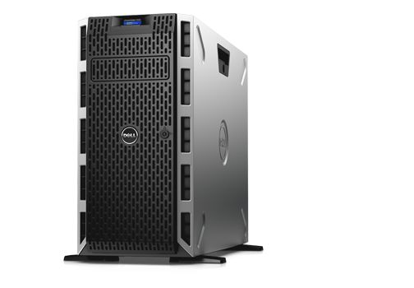

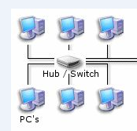

File Server (Physical Architecture)
Internet
File server
Data center
Wifi connection
Office
Mpls cloud

Slide 13






Case 3 storing files in backup storage
Case 1
File storing in central server
File Saved
Case 2 File storing in local machine
File stored
Save a file

Slide 14
Web Server

Slide 15
Web Server (Logical Architecture)
vH
VH
Apache App
OS
VH
VH
Apache app
OS
web servers
Mpls cloud
Virtual Hosting
DNS server
Proxy server
Host 1
Host 2

Slide 16
Web Server (Physical Architecture)
Internet
Intranet server
Data center
Mpls link
Wifi connection
Office
Mpls cloud

Slide 17
Web Access

Slide 18
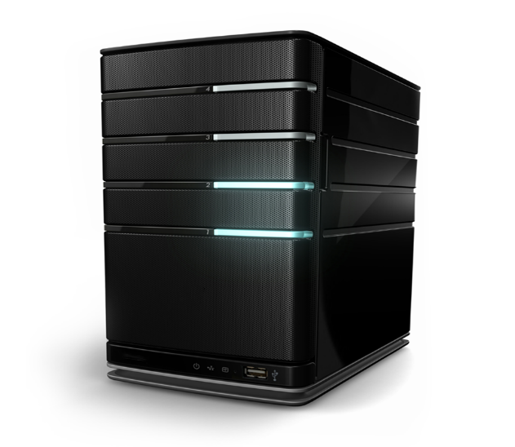


WEB ACCESS
Authentication server(local)
MPLS
Web server
Username:helloworld
Password:******
DNS server

Slide 19


REDUNDANCY WEB ACCESS
MPLS
Username:helloworld
Password:******

Slide 20
Directory Server

Slide 21
Directory Server (Logical Architecture)
Ldap monitor
LINUX OS
Ldap monitor
LINUX OS
Directory server
Mpls cloud
DNS server (slave)
Ldap server
(multi master)
Proxy server
Host 1
Host 2

Slide 22
Directory Server (Physical Architecture)
Internet
LDAP server
Data center
Mpls link
Wifi connection
Office
Mpls cloud

Slide 23
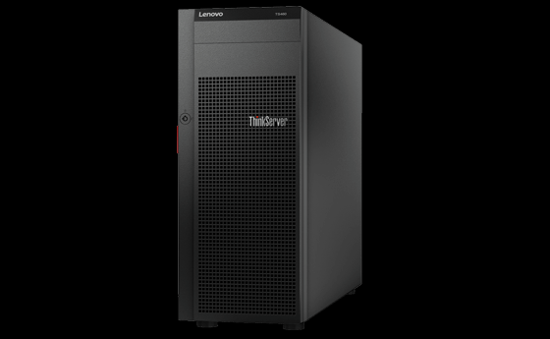


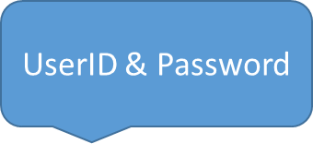

User Authentication
Local Server
Authentication Successful
Local Server
UserID & Password
Authentication succeeded
Centralized Server

Slide 24
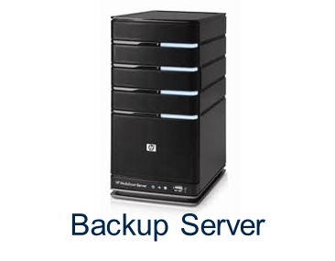
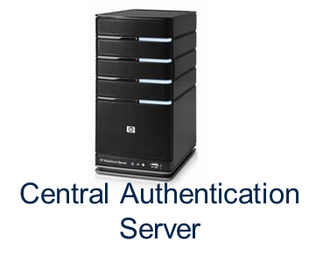
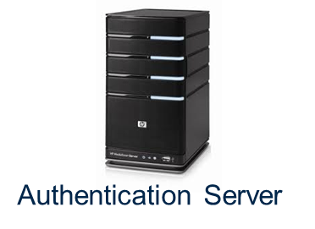
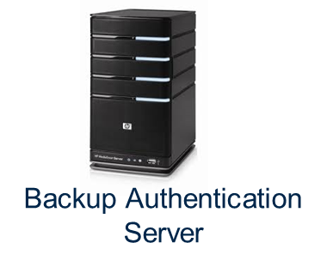


If central server fails
Authentication succeeded
CASE 3
CASE 1
CASE 2
If backup server fails
If Authentication Server fails
Authentication succeeded
Redundancy of
Authentication

Slide 25
Mail Server

Slide 26
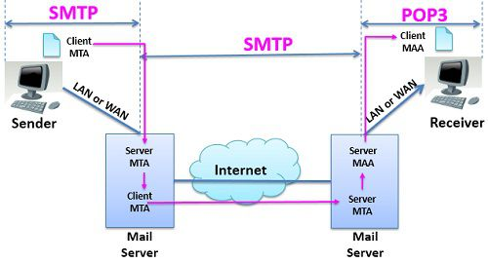
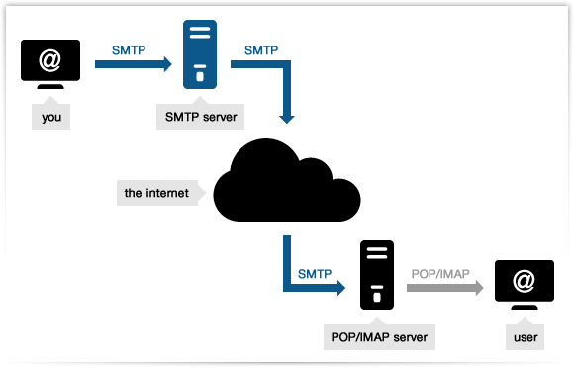
Overview : SMTP

Slide 27
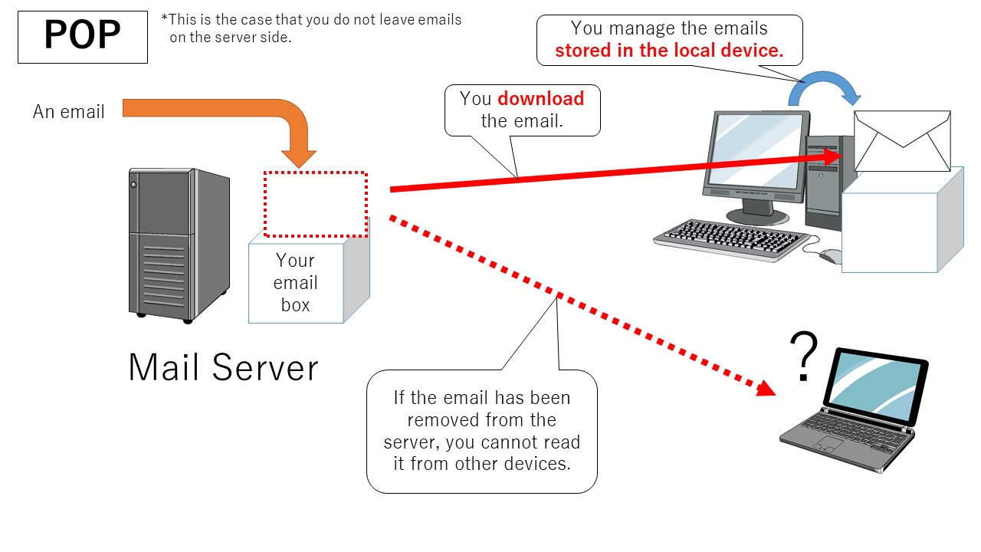
Overview : POP3

Slide 28
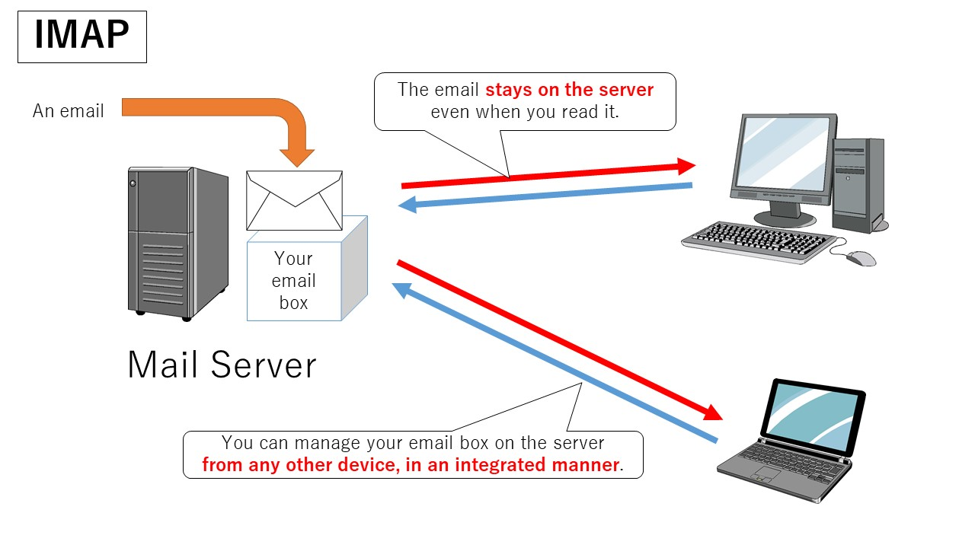
Overview : IMAP

Slide 29
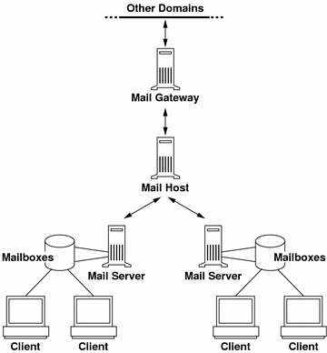

MAIL SERVER Architecture
MPLS cloud

Slide 30




MAIL SERVICE
Data Center - Bangalore
MPLS cloud
Mail Server
User is sending E-mail to same domain

Slide 31
MAIL SERVICE
Internet
MPLS cloud
Mail Server
MailBox
User is sending E-mail to other domain

Slide 32
SFTP

Slide 33
SFTP
SSH
Secure Shell
FTP
File Transfer Protocol

Slide 34
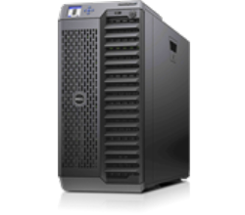

FTP
Client
Server
COMMAND
DATA
OK (Control Channel)
Data Channel
Port 21
Port 20

Slide 35




SSH
ABC
2&*ghh&%GYGGYG
ABC
SSH Client
SSH Server

Slide 36


SFTP Working
MPLS CLOUD
SFTP Server
(Port 22)
REQUEST

Slide 37
Printer Services

Slide 38
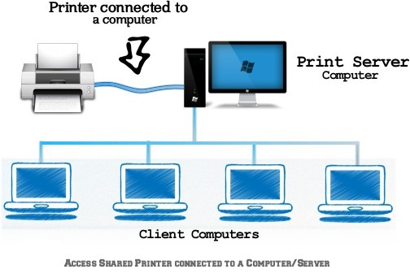
Printer Service

Slide 39
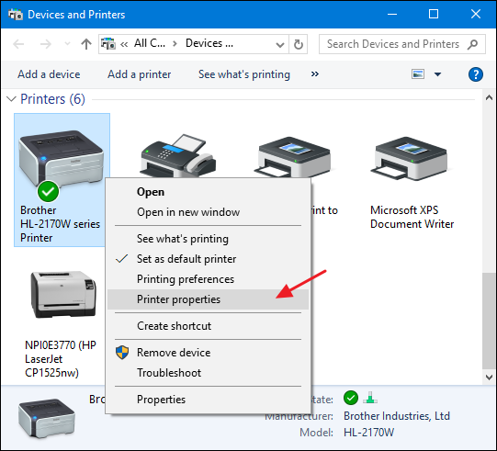
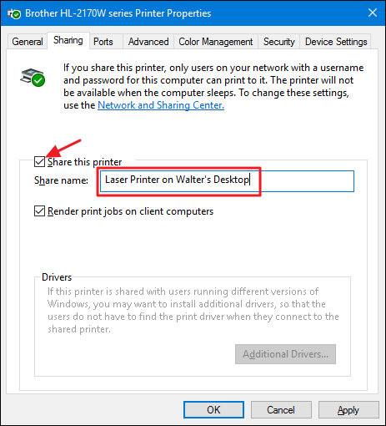

Slide 40


Slide 41




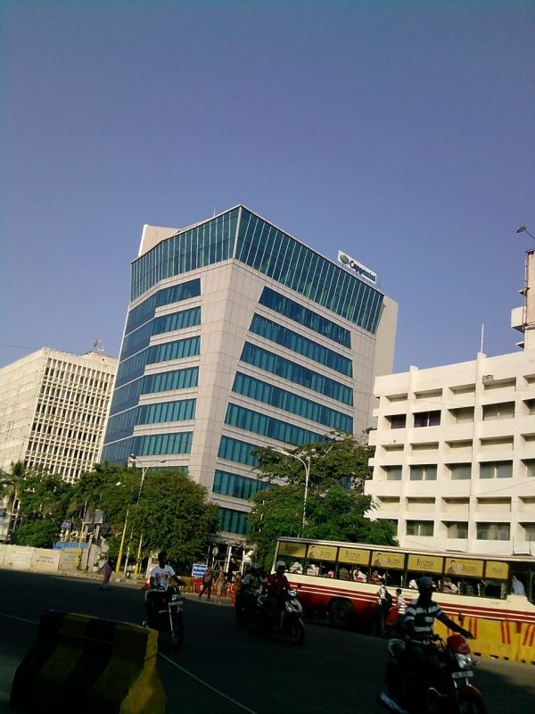

VPN service
Executive 2
Hello executive 2!
Executive 1
01010101010101010000010101001101…….
Hello executive 2!

Slide 42




PROXY SERVICES

Slide 43

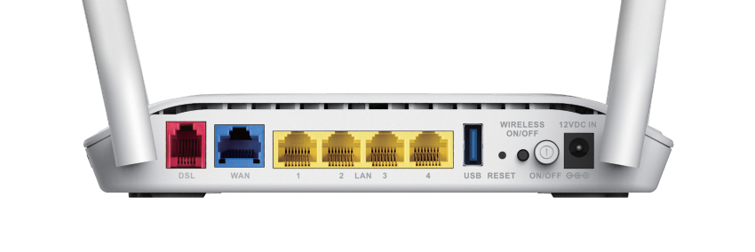


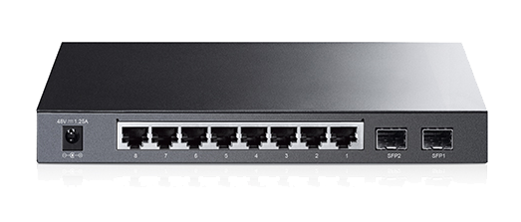



Modem
192.168.1.1
Airtel ISP
192.168.1.10
G : 192.168.1.1
How Proxy
Works ?
192.168.1.11
G : 192.168.1.1
192.168.1.12
G : 192.168.1.10
192.168.1.13
G : 192.168.1.10

Slide 44




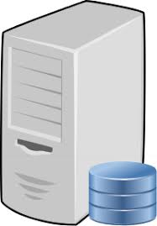
PROXY SERVICE

Slide 45



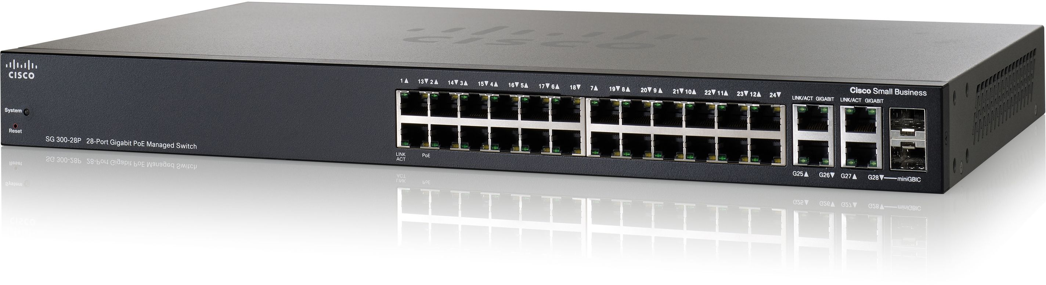

REDUNDANCY OF PROXY SERVICE
WEB SERVER
Fails
WWW.capgemini.com
PROXY SERVER
PROXY SERVER
Switch
URL is permitted!!

Slide 46
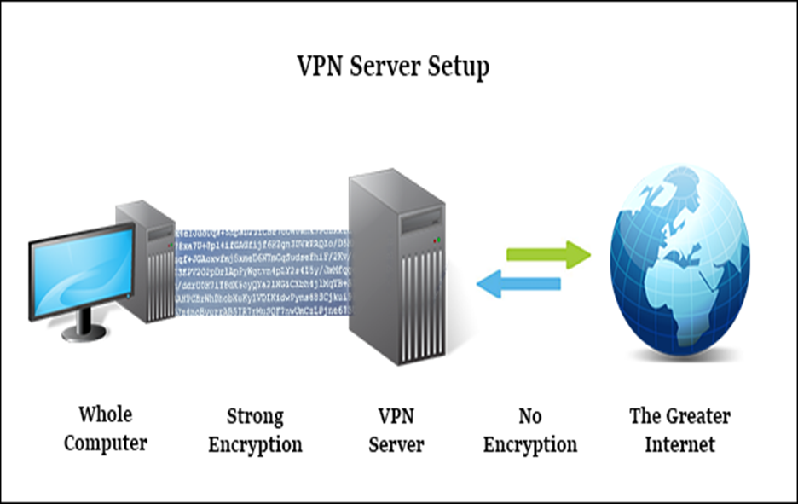
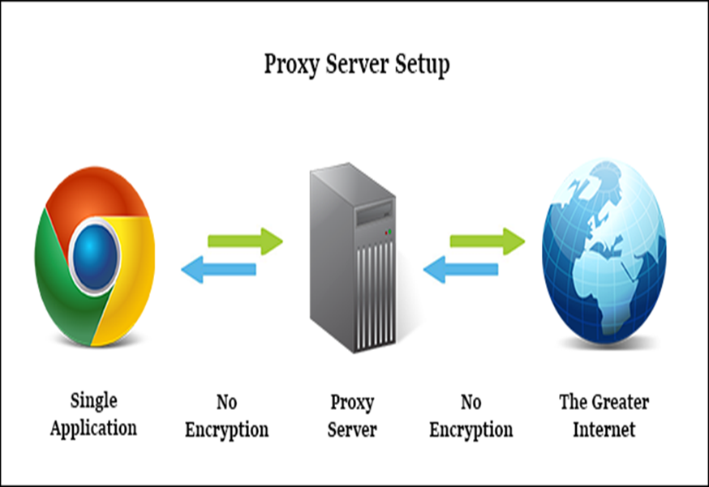

Slide 47
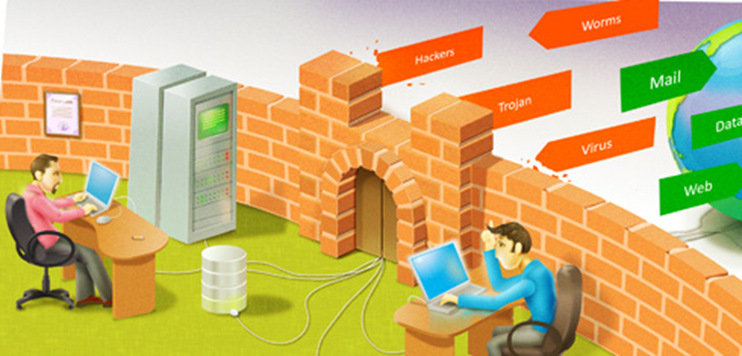
Firewall

Slide 48





Firewall
Domain
Access is denied!!
Proxy Server
Outside
environment

Slide 49


